Slide 1
Programming Basics
Ms Sastre

Slide 2
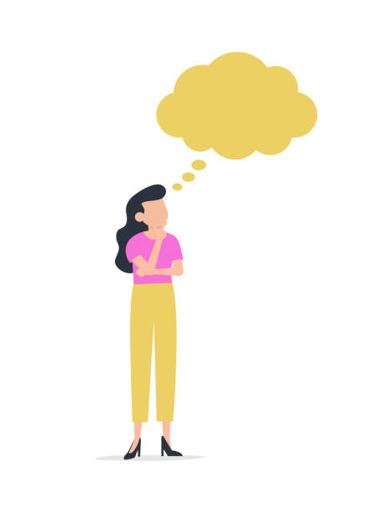
Think Like A Programmer
Do you need math's to be good at a jigsaw puzzle?
What are your morning routines?
Sequence of thought is key to programming.

Slide 3
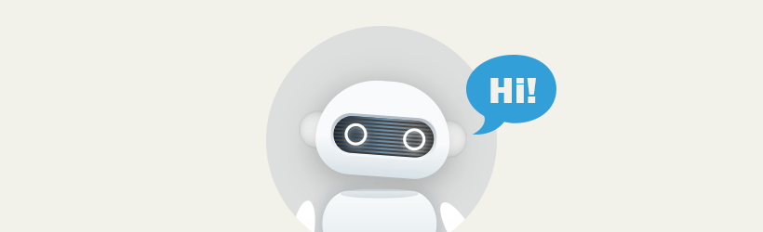
What is Programming?
Creation!
Its like teaching a baby to speak and understand.
The language computers use are programming languages.

Slide 4
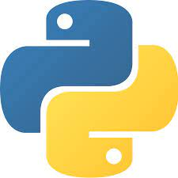
Python Programming Language
Beginner Friendly
Prioritizes readability, easier to understand and use.
Google, Instagram, YouTube, Reddit, Spotify and many more are created in Python.

Slide 5
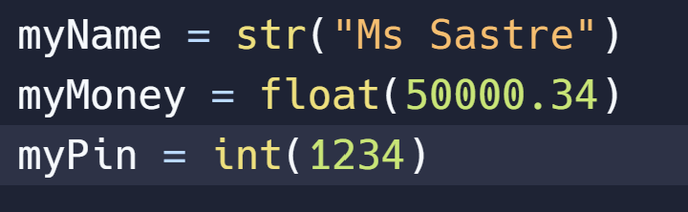
What Is a Variable?
A Variable is an unknown number.
Three Data Types
Integer = 1,2,3,4,5
Float = 1.2, 6005.4
String = “Hello”

Slide 6
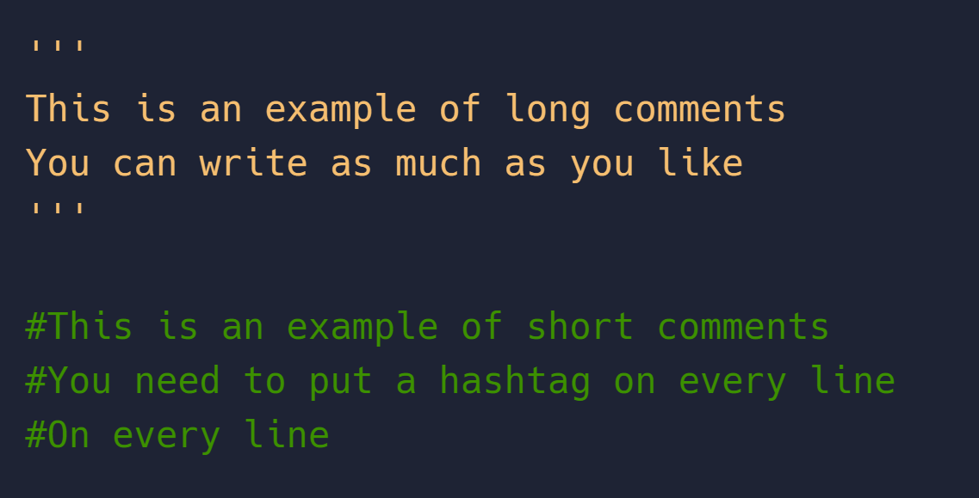
The Importance of Comments
Comments will not affect your code.
They are used to explain the code.
In Python we use ‘’’ or # to comment.

Slide 7

Using Print() Function
The print() function is used to display text.
You can display a full line of text.
Or you can use a variable.

Slide 8
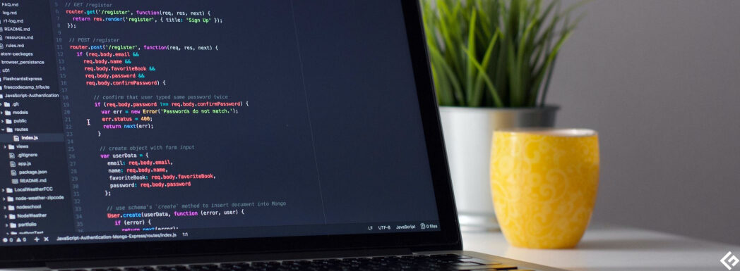
Lets Code!
https://replit.com/
print(“Hello World!”)

